Slide 1

Taxonomy
Much like thesaurus in terms of classifying and relating “things”
  Thesaurus deals with single words and is universal for a language
  Taxonomy deals with “concepts” and is specific to an application
Yahoo! Directory (dir.yahoo.com)
Open Directory Project (www.dmoz.org)
A particular field (e.g., medical science) or an organization has its own taxonomy
COMP 336 Dik Lun LEE Department of Computer Science, HKUST, Slide <number>

Slide 2
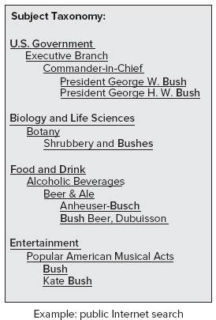
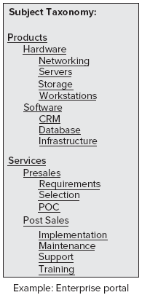
Subject-Based Taxonomy
Corresponding to how things are organized in an organization
  Think about how a company’s website is organized: Departments, products, services, etc.
COMP 336 Dik Lun LEE Department of Computer Science, HKUST, Slide <number>

Slide 3
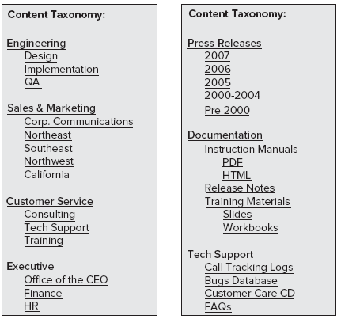
Content-Based Taxonomy
Contents do not always correspond to real world organizations
Contents are more abstract
than departments and
products
Think of organizing all of the
documents in an organization
based on their contents, not
by who owns the documents
COMP 336 Dik Lun LEE Department of Computer Science, HKUST, Slide <number>

Slide 4
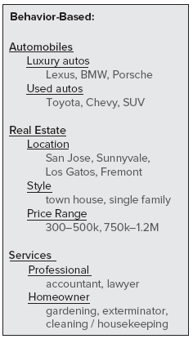
Behavior-Based Taxonomy
What is shown on the taxonomy depends on how often they were accessed by users
In the example, maybe the first
two levels are fixed, but the lowest
level is dynamically generated
COMP 336 Dik Lun LEE Department of Computer Science, HKUST, Slide <number>

Slide 5
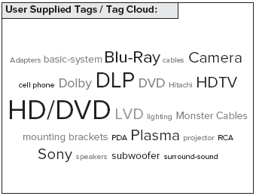
Tag-Cloud: Visualization of Taxonomy
The nodes could be dynamic, e.g., tags enters by authors and viewers, which are unpredictable
Could be a combination of content-based and behavior-based taxonomy: Each page has pre-defined content keywords and what are shown (and their sizes) depends on access frequencies
COMP 336 Dik Lun LEE Department of Computer Science, HKUST, Slide <number>

Slide 6
Ontology
Compared to taxonomy, ontology contains more refined and application-independent concepts (i.e., describe the world)
Billiard Game
Meaning ID 1265
Define concepts and relationships among concepts
The word “pool” have different meanings:
  As in “swimming pool”
  As in “billiard game”
  As in “puddle”
The meanings can be disambiguated by the related concepts
  What does “pool” mean in “I like the pool and hot tub in the hotel.”
Swimming Pool
Meaning ID 7099
Diving board
Meaning ID 7081
Cue Stick
Meaning ID 1267
Hot Tub
Meaning ID 7141
Rainwater
Meaning ID 4961
Puddle
Meaning ID 458
COMP 336 Dik Lun LEE Department of Computer Science, HKUST, Slide <number>

Slide 7
Summary
 | Dictionary | Thesaurus | Taxonomy | Ontology
“End” Users | People | People / Machine | People / Machine | Machine
Knowledge Granularity | Single words | Single words | High-level subjects | Fine to high-level concepts
Hierarchy | - | Tree + relations between words | Tree + cross links between subjects | Graph
Applications | Linguistics | Linguistics | Web | Web / AI
COMP 336 Dik Lun LEE Department of Computer Science, HKUST, Slide <number>

Slide 8
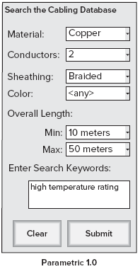
Faceted and Parametric Search
Taxonomy, faceted and parametric searches are very similar (same thing invented by different people)
  Data have multiple attributes (facets)
  User can restrict search by selecting the facet
  categories on the advanced search interface
  Unfortunately, users rarely use the advanced
  search interface (did you use Google’s advanced
  search?)
COMP 336 Dik Lun LEE Department of Computer Science, HKUST, Slide <number>

Slide 9
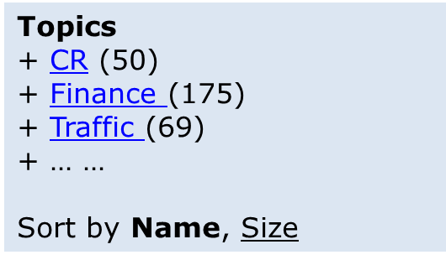
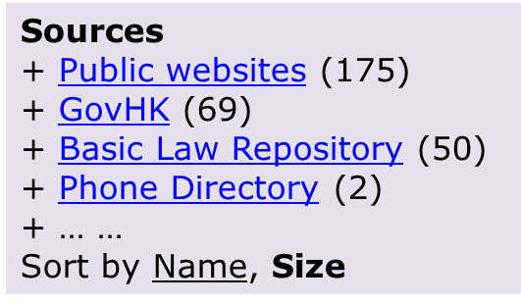
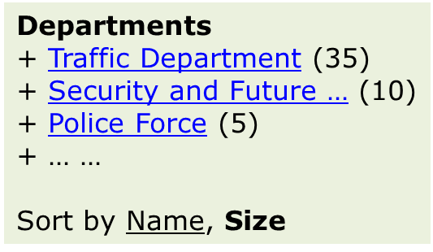
Taxonomy Search
Search result is a linear list of pages; there is no apparent relationships between the pages other than ranking
Taxonomy provides a semantic map of the results; search “regulation” results are mapped on taxonomies
SE
Taxonomies
Search results
Number of results under the topic; click to see results
COMP 336 Dik Lun LEE Department of Computer Science, HKUST, Slide <number>

Slide 10
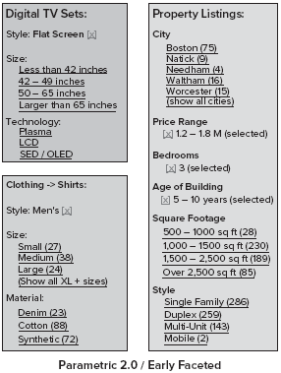
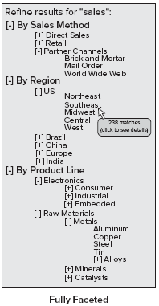
Faceted and Parametric Search (cont.)
Better design: user performs a general search (no facet) first
Then, search results are presented together with relevant facets
Simpler:
One level
Non-expandable or shrinkable
COMP 336 Dik Lun LEE Department of Computer Science, HKUST, Slide <number>

